Slide 1



CLPS Incorporation
Nasdaq: CLPS

Slide 2
Chapter 12
Getting started with mybatis
CLPS Incorporation

Slide 3
Catalogue
1. MyBatis Overview
2. MyBatis下载与安装
2. MyBatis Download and Installment
3. How Mybatis Works
4. Addition, deletion and modification of mybatis
5. Using the resultmap property to map query results
6. Using mapper interface to execute SQL

Slide 4
12.1 MyBatis Overview
Mybatis is an excellent persistence framework that supports normal SQL queries, stored procedures, and advanced mapping. Mybatis eliminates almost all manual setup of JDBC code and parameters and retrieval of result sets. Mybatis can use simple XML or annotation to configure and map basic data types, and map interface and Java POJO (plain old Java objects) to records in database
Comparison with hibernate, a persistence layer framework

Slide 5
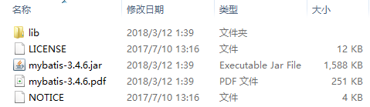
12.2 MyBatis Download and Installment
Through official web: https://github.com/mybatis/mybatis-3/releases Download the latest version of MyBatis mybatis-3.4.6.zip 。
MyBatis File structure of compressed package

Slide 6
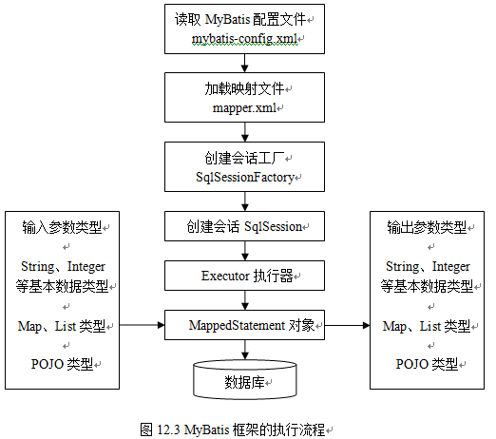
12.3 How MyBatis Works
Execution flow chart of mybatis framework

Slide 7
12.3 How MyBatis Works
When you use MyBatis to operate the database, go through the following steps roughly.
(1) Read mybatis configuration file mybatis-config.xml
(2) Load mapping file mapper.xml
(3) Create session factory
(4) Create session
(5) Operating database through executor
(6) Mapping of input parameters and output results

Slide 8
12.4 Addition, deletion and modification of MyBatis
Add the core package necessary for mybatis in Java or Java Web project, and you can add, delete, modify and query the data table. Next, take the data table user ﹣ info in the MySQL database eshop as an example, and use mybatis to add, delete, modify and query the data.
Query users according to user number, fuzzy query users according to user name
Add user
Modify user
delete user

Slide 9
12.5 Using the resultmap property to map query results
In the above example, the attribute name in the entity class UserInfo is the same as the field name in the data table user_info. If the attribute name is different from the field name in the data table, you need to use the resultMap attribute to map the result set.

Slide 10
12.6 Using mapper interface to execute SQL
In the test method of test class MybatisTest, the methods such as selectone, selectlist, delete and update are called through sqlSession object. In these methods, you need to specify the ID of the execution statement in the mapping file (such as finduserinfobyid). If the spelling of the ID is wrong, it can only be found at run time. For this reason, MyBatis provides another programming method, that is, using mapper interface to execute SQL, so as to avoid the above situation, and at the same time, it is more in line with the habit of java interface oriented programming.

Slide 11
12.6 Using mapper interface to execute SQL
The following specifications need to be followed when developing with mapper interface ：
The namespace in the mapping file is the same as the classpath of the mapper interface.
In the mapper interface, the method name is the same as the ID of the execution statement defined in the mapping file.
The input parameter type of the method is the same as the parameter Type of the execution statement defined in the mapping file.
The method output parameter type is the same as the result Type of the execution statement defined in the mapping file 。

Slide 12
12.7 Review
This chapter introduces the concept, download, installation and working principle of mybatis framework, and explains the basic usage of mybatis framework in detail combined with the operation of adding, deleting, modifying and querying the data table "user info".
Through the study of this chapter, I believe that the readers have a preliminary understanding of the mybatis framework. Move on and learn more about the mybatis framework in the next chapter。

Slide 13

Thank You

